Slide 1
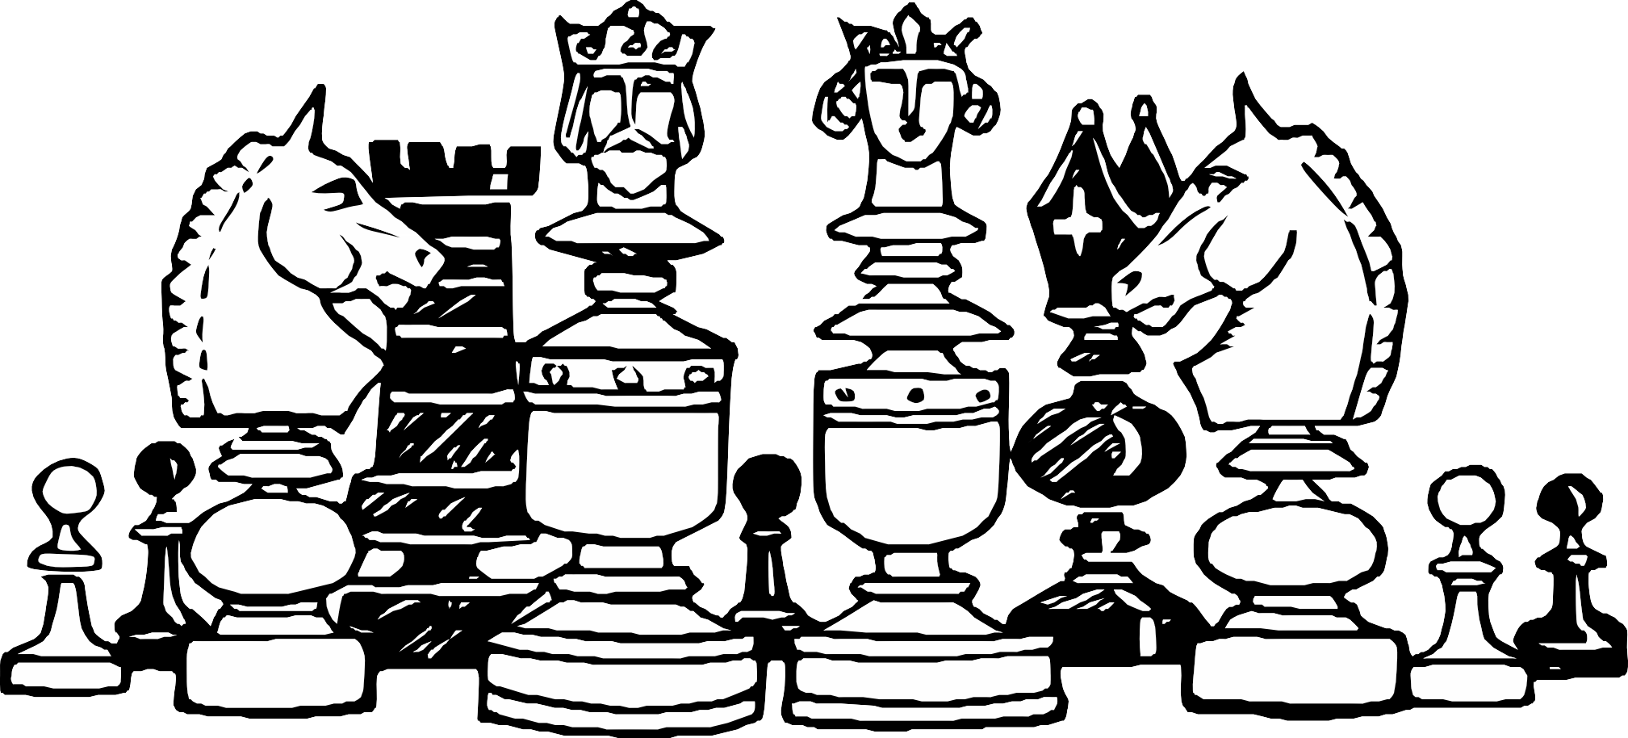
CHESS GAME USING PYTHON

Slide 2
CONTENT
01
Introduction to Topic
02
Application
Hardware or Software Requirenments
03
04
ProcessFlow and Advantages
Contribution of each member
05

Slide 3
Introduction
Chess is a game played between two opponents on opposite sides of a board containing 64 squares of alternating colors.
Each player has 16 pieces: 2 rooks, 1
king, 1 queen, 2 bishops, 2 knights
and 8 pawns.

Slide 4
Application
The Scope of our project is for two players to play chess as real in Computer and also a player can play with the computer according to the intelligence we gave it

Slide 5
Application
Objective - The Objective is to checkmate the opponent's king by placing it under a unavoidable threat of capture.

Slide 6


Software Requirements
Python3- It is a general purpose programming language which provides the high level redability and it is interpreted. In our project we use python to calculate the players move.

Slide 7

Software Requirements
Pygame- Pygame is a python framework for game programming. We use pygame in our project for creating, updating and handling GUI.

Slide 8
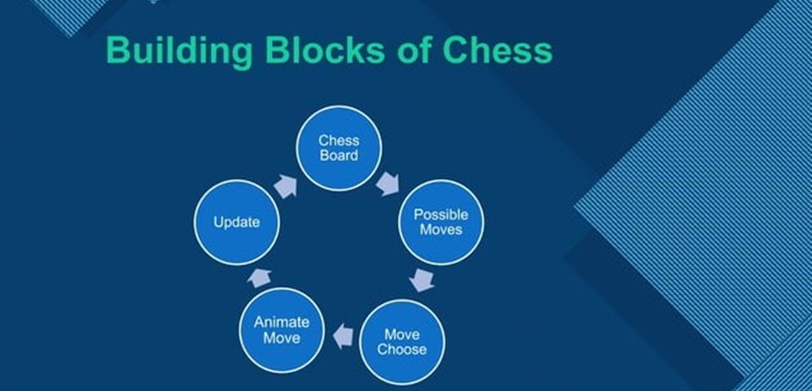
Process Flow

Slide 9
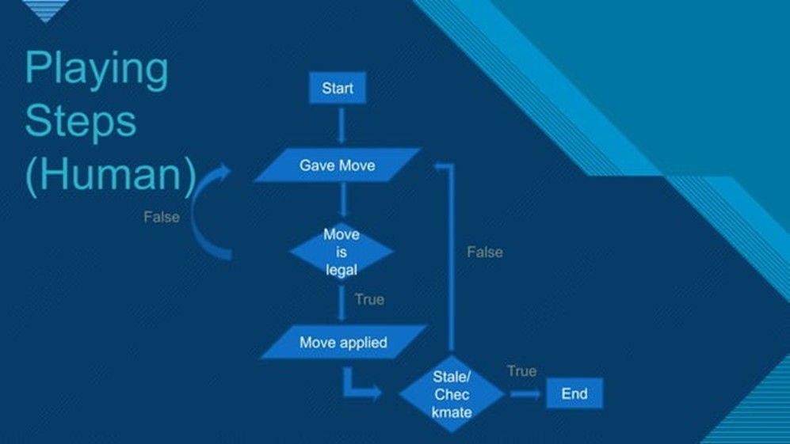
Process Flow

Slide 10
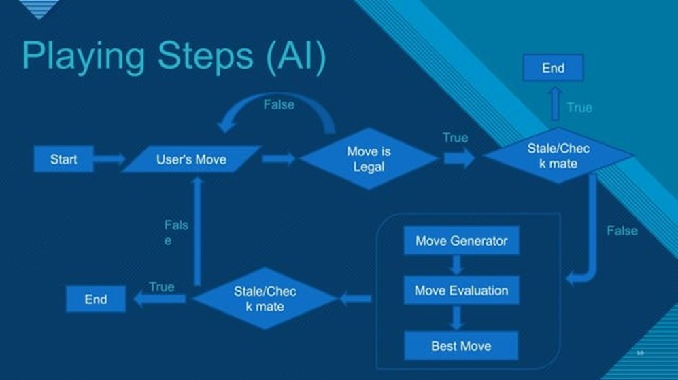
Process Flow

Slide 11

Need for intelligent Chess Engine
we should introduce two things to computer for making the game Intelligent which will make the game to do optimal moves -
A technique to choose the move to make amongest all legal possibilities, so that it can choose a move instead of being forced to pick one at random.
A way to compare moves and positions, so that it makes intelligent choices.

Slide 12

Algorithm for Chess Engine
1. MiniMax Algorithm
The Mini-max algorithm is a way to find an optimal move in a two player game.
Mini-max algorithm is a recursive or backtracking algorithm which is used in decision making and game theory. It provides an optimal move for the player assuming that opponent is also playing optimally.
The minimax algorithm performs a depth-first search algorithm for the exploration of the complete game tree.
The minimax algorithm proceeds all the way down to the terminal node of the tree, thenbacktrack the tree as the recursion

Slide 13
Working of MiniMax
Minimax: Assume that both White and Black plays the best moves. We maximizes white score.
Perform a depth-first search and evaluate the leaf nodes Choose child node with highest value if it is White to move Choose child node with lowest value if it is Black to move

Slide 14
Algorithm for Chess Engine
2. Alpha-beta Pruning
Alpha-beta pruning is a way of finding minimum solution
Alpha-beta pruning is a modified version of the minimax algorithm. It is an optimization technique for the minimax algorithm
The Alpha-beta pruning to a standard minimax algorithm returns the same move as the standard algoritm does, but it removes all the nodes which are not really affecing the final decision but making algoritm slow. Hence by pruning these node, it makes the algoritm fast.

Slide 15
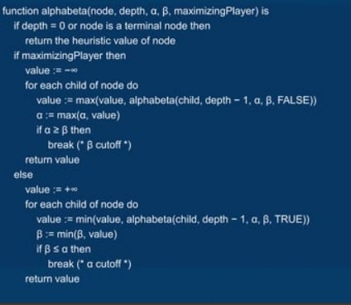
Algorithm for Chess Engine

Slide 16
Advantages of our Chess Engine
Points - Their will be a point system in the game when a person wins he can check his points.
2 player - The player can play with the cpu and as well as his friend as 2nd Player.
Multiplayer - We will try to host a sever where a player can play online with players all over the world.

Slide 17
Group Members
Manan Sharma (21BCE10210)
Arnav Sinha (21BCE10168)
Shivang Choudhary (21BCE10188)
Arvind Garg (21BCE10184)
P.Harshit Kumar (2BCE10709)

Slide 18
Thank you Sir for providing us a wonderful Project
Dr. Vijay Kumar Trivedi

